Slide 1
Vad vet vi idag om psykoterapi? Rolf Sandell Stockholm 26 oktober 2017

Slide 4
Effektstorlek (ES) = 0,80
-If psychotherapy were an intervention designed to help people lose weight, the average American male would lose ~54 lbs. The average American female would lose ~62 lbs. -If psychotherapy were an intervention designed to increase intelligence, the average person would gain ~12 IQ points. -If psychotherapy were an intervention designed to increase annual income, the average salaried employee in America would get a $27,200 raise (from $37,500 to $64,700; based on 2008 data from the US Bureau of Labour Statistics).

Slide 5
”Medelvärdesillusionen”

Slide 6
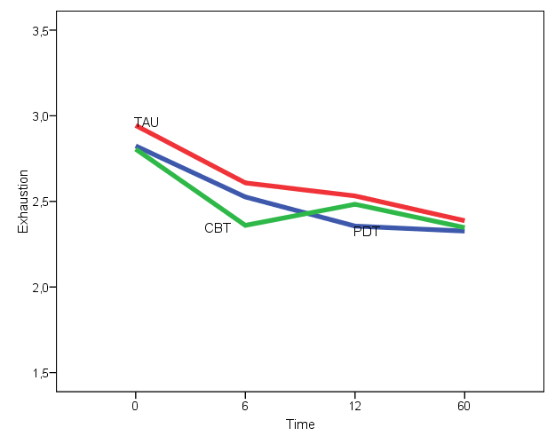
120 Burnout patients (Oldenburg Burnout Inventory, OLBI)

Slide 7
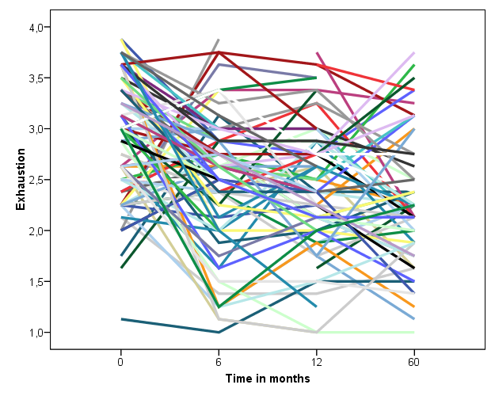
120 Burnout patients

Slide 8
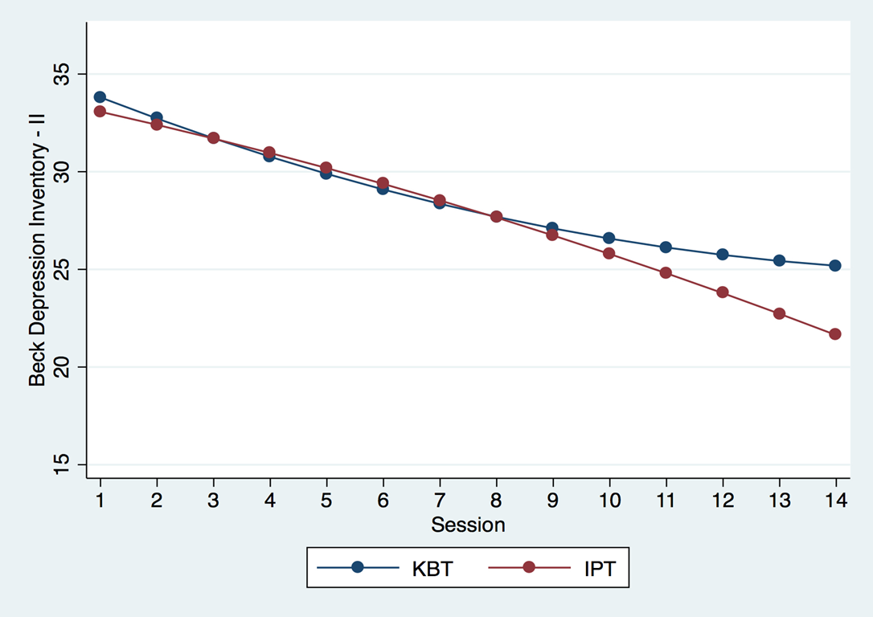

Slide 9
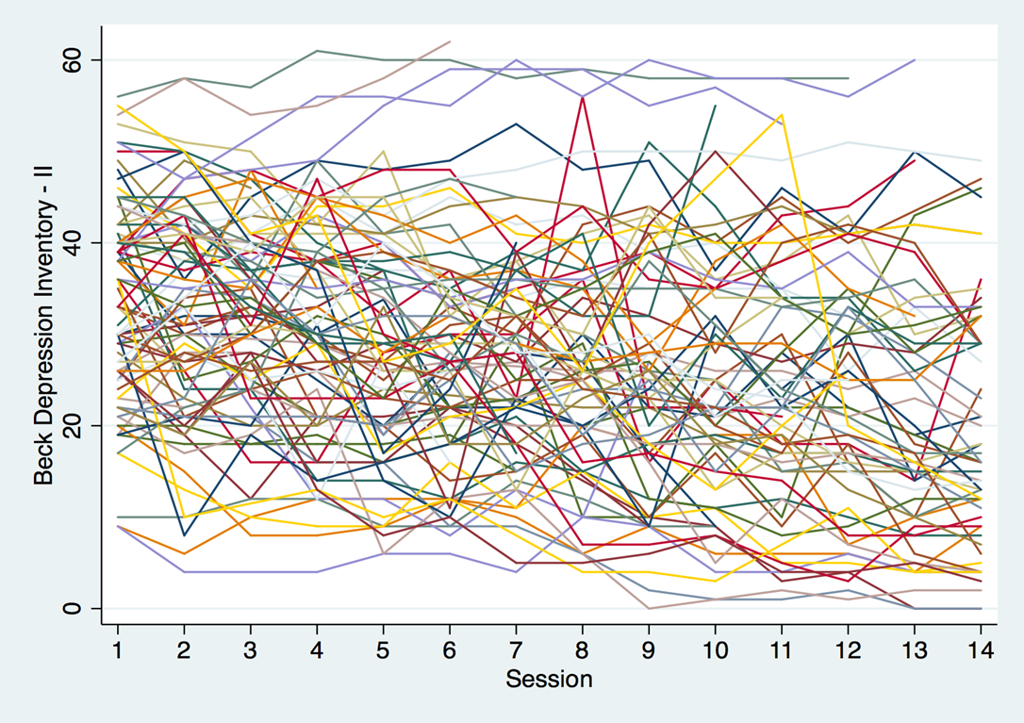

Slide 10
En nödvändig insikt:
Ca 10% börjar inte
Ca 20% avbryter
40-50% (av dem som är kvar) förbättras,
40-50% förändras inte
och 5-10% försämras (fast kanske ca 20%?)
(Kraus et al., 2011; Swift et al., 2017)

Slide 11
Och den variationen är inte slumpmässig!

Slide 12
Norcross & Lambert, 2006:

Slide 13
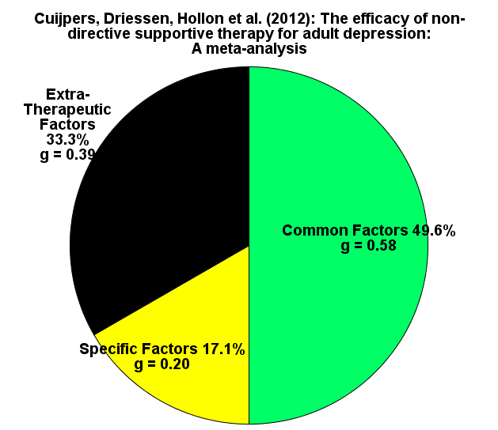

Slide 14
Patienten är en avgörande ”terapeutisk faktor”
Stödjande omgivning
OK sociala förhållanden
Funktionsnivå
Mentala förutsättningar: ”jagstyrka”)(PD
Bra relationer (inre och yttre)
Säker anknytning (också till terapeuten)
Optimism/pessimism
Preferenser
Förväntningar
”Inre” motivation
Självreflektion
Lyckliga (eller olyckliga) tillfälligheter

Slide 15
De terapeutiska relationerna …
Behandlingsalliansen
Överföringen/
Den reella relationen
Den reparativa/kompensatoriska relationen
Den ”transpersonella” (biologiska?) relationen

Slide 16
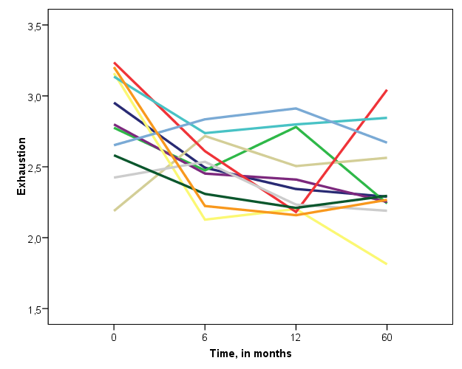
… och terapeuten

Slide 17
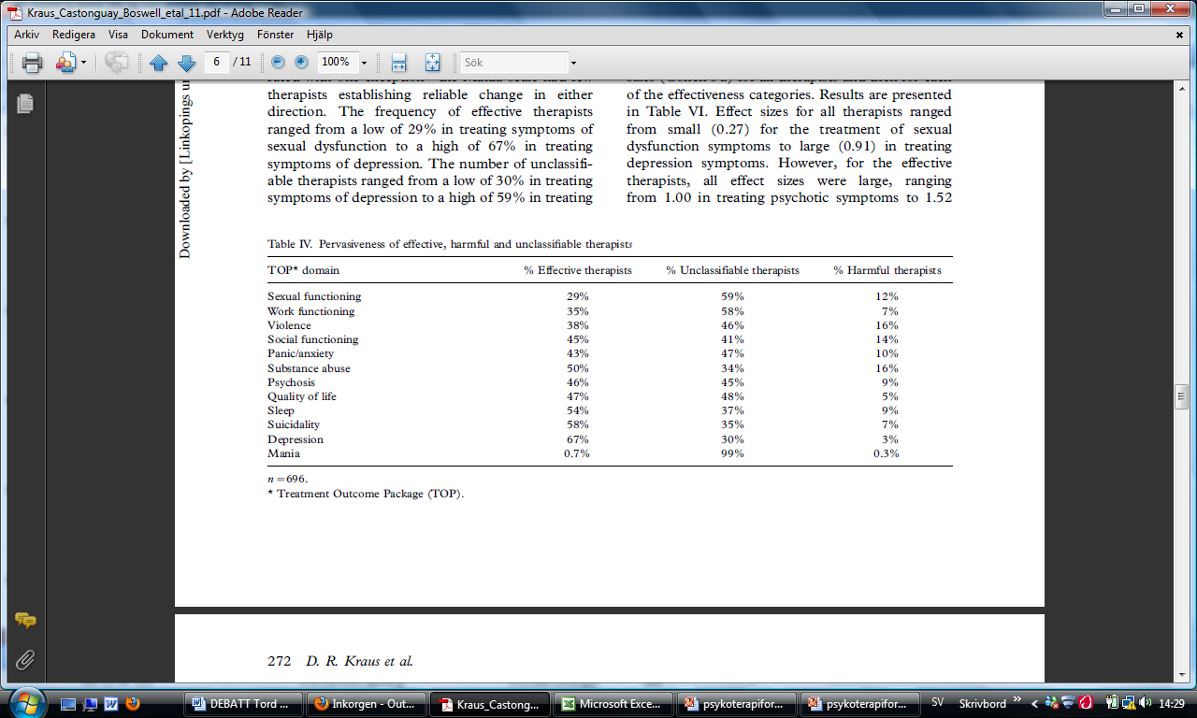

Slide 18
Mentalt välbefinnande och ”god anpassning”
”Empathy” (Rogers)
”Nonpossessive warmth” (Rogers)
”Congruence/genuineness” (Rogers)
”Unconditional regard” (Rogers)
Relationskompetens
Trygg anknytning
Professionell erfarenhet
Ideal och attityder
Vårdorganisationens struktur, ”trygghet” och ledarskap

Slide 19
Men ”metoden”, då?

Slide 20
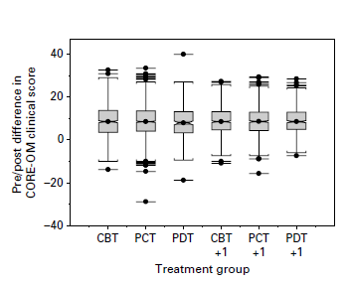
Stiles, Barkham, Clark-Mellor & Connell, 2008 (N = 5613)

Slide 21
”In the past 4 decades about 500 randomized trials have examined the effects of psychological treatments of adult depression. In this article the results of a series of meta-analyses of these trials are summarised. Several types of psychotherapy have been examined, including cognitive behaviour therapy, behavioural activation therapy, interpersonal psychotherapy, problem-solving therapy, nondirective supportive therapy, and short-term psychodynamic psychotherapy. All therapies are effective and there are no significant differences between treatments.” (Cuijpers, 2017)

Slide 22
”14 studies totaling 1073 patients were included. PDT was found to be significantly more effective than control conditions (g = 0.64). PDT did not differ significantly from alternative treatments at post-treatment (g = 0.02), follow-up (FU) up to a year (g = -0.11), and FU past a year (g = -0.26). … Overall, PDT was shown to be as efficacious as other active treatments that have been studied for anxiety disorders” (Keefe, McCarthy, Dinger, Zilcha-Mano, & Barber, 2014)

Slide 23
Är olika terapiformer lika bra i genomsnitt – men på olika patienter?

Slide 24
Aptitude x treatment (x outcome)
Beutler: Systematic Treatment Selection
Dance & Neufeld: internal/external coping
Blatt: anaclitic v. introjective personality, perfectionism
Lazarus: förväntningar
Swift m fl: preferenser
Den kritiska frågan: Vilken psykoterapi för vilken patient (och med vilket slags effekt)?

Slide 25
”[A] sound argument for not limiting psychotherapeutic options to CBT or any other single treatment is that no approach will work for all individuals. Thus, it is essential that alternative approaches are available for those who fail to benefit from the initial treatment” (DeRubeis & Lorenzo-Luaces, 2017).
Personalized /customized treatment

Slide 26
Systematic Treatment Selection (Beutler, Clarkin & Bongar, 2000)
Problem severity/functionality
Problem complexity
Subjective suffering/distress
Reactance/resistance potential
Internal/external coping style
www.systematictreatmentselection.com

Slide 27
Personalized Advantage Index [CBT)(ADM] (DeRubeis et al., 2015)
Age
Intelligence
Marital status
Employment status
Life events
Personality disorder
Previous ADM

